Slide 1
Injury Exploration
Parker Booth & Isaac Clark
Notes:
Hi, I'm Isaac Clark and this is my partner Parker Booth

Slide 2
Introduction
Lower body soft tissue injuries (STI) make up approximately 60% of all injuries across sports.
Lower body STIs involve damage to the muscles, ligaments, and tendons from the midsection down.
Looked for relationships between injuries and force plate characteristics
Double-leg countermovement jump testing using force plates is widely available, relatively inexpensive, easy to test, and collects a variety of movement characteristics.
Notes:
60% of all injuries
Lower body STIs definition
Looking for relationships
Why we used countermovement jump.

Slide 3

Research Questions
Which force plate countermovement jump characteristics are related to lower body STI?
Can injuries be anticipated using force plate data?
Will these insights aid in injury prevention?
Notes:
What characteristics are related?
Can injuries be anticipated?
Will it help injury prevention?

Slide 4
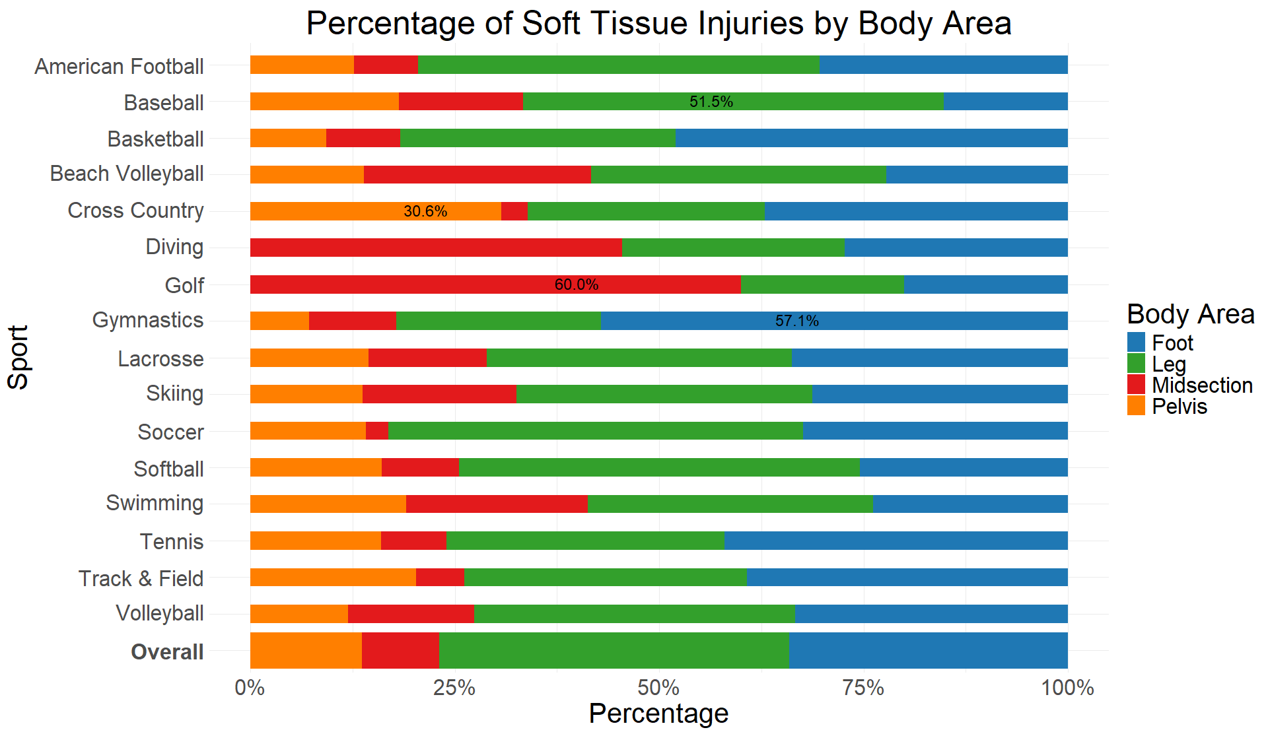
Exploratory Analysis
Demands for each sport.
Grouped sports with similar demands for analysis.
Distribution of Injuries
Correlation & linear relationship analysis.
Looked for relationships between force plate metrics and injury.
Conducted by Sport, Injury Type, and Side of Body.
Notes:
Ran Linear Analysis on Metrics Relevant to Demands of sport

Slide 5
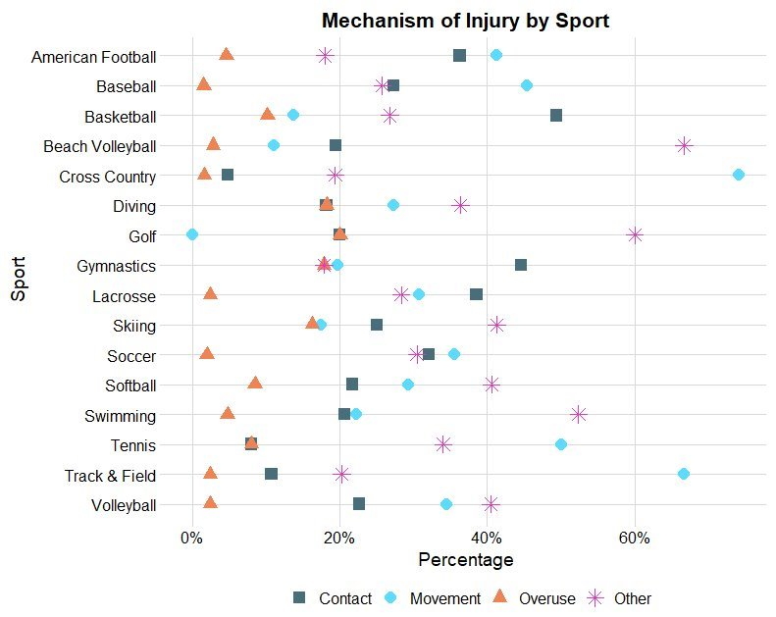
Exploratory Analysis
Analysis on the Mechanism of Injuries
Movement: Jump, Run, Acceleration
Contact: With Ground, Tackled, Fall, Landing
Overuse: Overload, Repetitive Use
Other: Unknown, Misc., Other
Large number of Contact & Other Injuries throughout sports
Notes:
Contact is large
10/16 sports have contact/unknown as most common

Slide 6
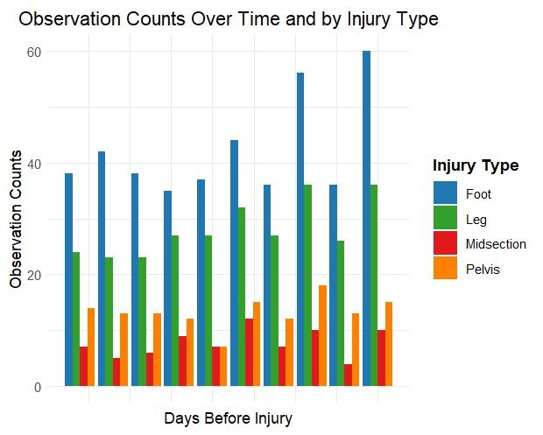
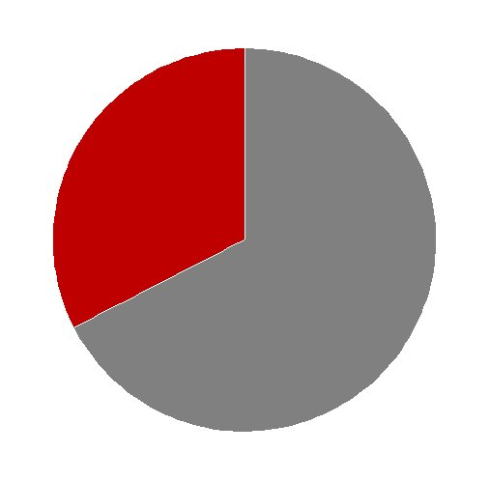
Limitations
The number of observations of injuries and force plate tests were low for some sports.
Contact STIs represented approximately one-third of all observed injuries.
The randomness of contact injuries introduces excess variability.
Variations in injury reporting.
Not controlling for landings on jumps restricted the use of other potentially relevant metrics for predicting injuries.
Contact:
32.56%
Other:
67.44%
Contact:
32.56%
Contact:
32.56%
Other:
67.44%
Other:
67.44%
Notes:
Contact Injuries 1/3
Literature referenced drop jumps

Slide 7
Methods
All force plate data was collected using double-leg countermovement jumps
Injury timeframes were specified as a 6-month period leading up to injury.
Sports were grouped by similar demands for analysis.
Two Similar Field Sports; Two Similar Court Sports.
These relationships were compared using data from force plate jumps collected in the month preceding an injury event to the average jump results from the previous five months.
A Cox-PH model was run on the Court Sport injuries.
Baseline values for athletes were the first 3 months of the injury timeframe.
Jump height and flight time test results from the 3 months prior to injury were compared to baseline values.
Notes:
Historical Injury Data
Explain Timeframes

Slide 8
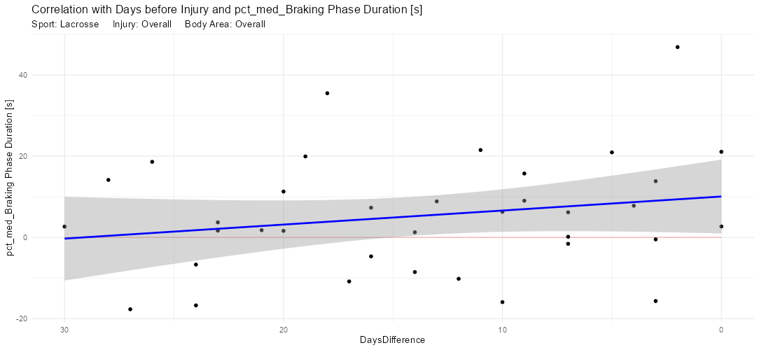
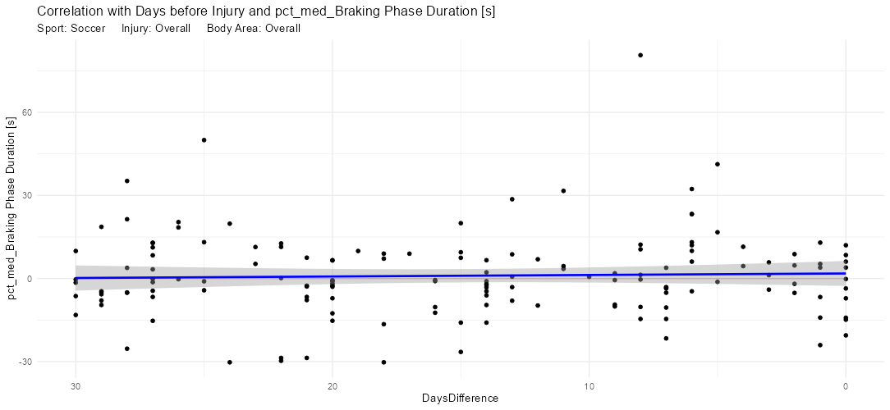
Results
Small relationships somewhat existed for Single-Team analysis.
Relationships were weak and inconsistent.
These small relationships disappeared when analyzing between teams with similar sport-specific demands.
Correlation and linear relationship analysis returned near-zero results for most sports and injuries.
Any statistically significant relationships were further investigated by grouping similar sports but still yielded no results.
Asymmetry analysis returned similar results.
Conducted using asymmetry force plate metrics.

Slide 9
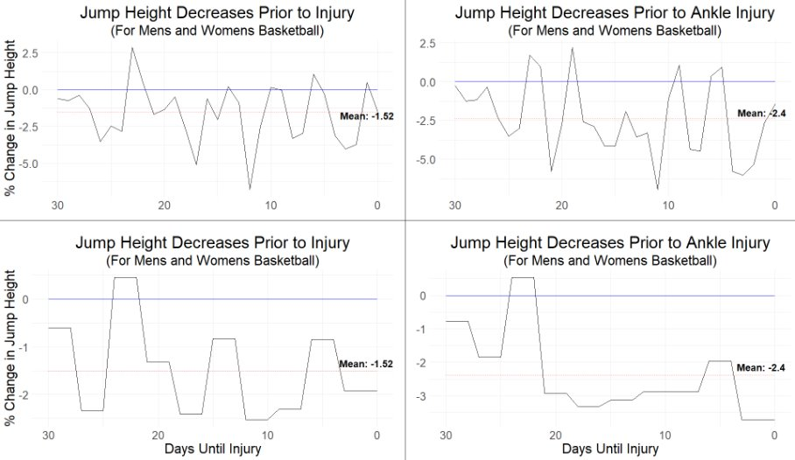
Results
Most significant relationship found.
Statistically Significant but not large deviations.
1%-2% changes
Not enough of a change to be extremely relevant.

Slide 10
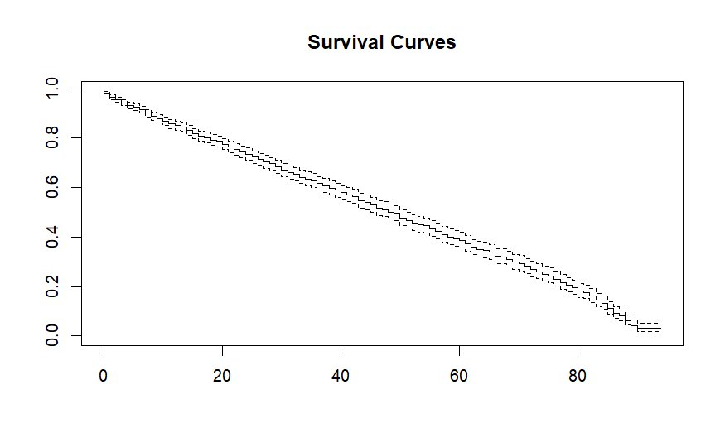
Results
The cox-ph model was designed to predict the "survival time" that passes until an event occurs.
Modeled the effects of jump height and flight time on Court Sport Injuries.
Model did not provide significant results
All statistical checks within the model provided insignificant values
Coefficients for flight time and jump height trended in opposing directions
Cox Proportional-Hazards Model
Notes:
Looking further into our strongest relationships with basketball
What is a CoxPH model?
We used time until the injury
graph shows our survival curve x, y axis
CoxPH is typically more curved
Indicates reliance on "time to" metric
Indicates a lack of consistency in data
p-values was around a 0.5
flight time and jump height trend in opposite directions.

Slide 11
Literature Support
One paper found no significant association between the preliminary force plate test and the likelihood of experiencing either an MSKI or a lower body MSKI. ^{[2]}
Another research paper found that that only 8% of countermovement jump studies observed an association with injury risk. ^{[1]}
79% of studies using drop jump were able to observe a relationship, implying that the landing element of jump testing is superior in identifying risk of injury.
[1] Pedley, J. S. (2020) Utility of kinetic and kinematic jumping and landing variables as predictors of injury risk: A Systematic review. Journal of Science in Sport and Exercise
[2] Hando, B. R. (2022) The use of force plate vertical jump scans to identify special warfare trainees at risk for musculoskeletal injury: a large cohort study. The American Journal of Sports Medicine
Notes:
Want to see if literature supports our results
A lot of the research conducted in this area support our own findings.
Research papers (USAF Spec Forces)
Research Paper (review of 40 papers)

Slide 12
Looking Forward
Analyzing contact injuries separately.
Would help remove some variation and provide more concrete results.
Incorporating other data sources from different technologies (wearable IMUs).
Allows for comparisons with variables such as training load or decelerations.
Previous research found players were 50-80% likely to sustain a preseason injury when training consisted of long and frequent, high-intensity workouts. ^{[3]}
Another study found that athletes with a lower intermittent aerobic fitness compared to the average were more likely to be injured. ^{[4]}
Controlling for landings in countermovement jumps or analyzing drop jumps.
Could potentially help determine relationships using different characteristics.
Is it still possible to predict injuries using other methods of analysis and testing characteristics?
[3] Gabbett, T. J. (2010) The development and application of an injury prediction model for noncontact, Soft-Tissue injuries in elite collision sport athletes. The Journal of Strength and Conditioning Research
[4] Fort-Vanmeerhaeghe, A., (2020) Higher Vertical Jumping Asymmetries and Lower Physical Performance are Indicators of Increases Injury Incidence in Youth Team-Sport-Athletes. The Journal of Strength and Conditioning Research
Notes:
Analyze Contact Injuries separately
Incorporate other data sources
Research (two studies support training loads)
Control for landings
Is it still possible?

Slide 13
Conclusions
Statistical models did not substantiate significant relationships between force plate characteristics and lower body STIs.
Countermovement jump characteristics are not a direct indicator of injury.
Related literature supports the conclusion against a direct relationship between countermovement jump characteristics and lower body STIs.
Added analysis with differing data sources and analyzing different relationships could help
Notes:
Statistical models not suportive
Implies that CMJ is not a direct indicator
Related literature supports our conclusions
Hopes for added analysis
Thank Anna, Gretchen, Scott and Beverley. and the university of utah athletics dept.

Slide 14

Questions

